Slide 1

IPL 2025 Ball-by-Ball Performance Analysis Using Web Scraping and Exploratory Data Analytics
Batch No: 457
Project Associates:
Kora Kasi Obul Reddy
Jaggumanthi Nagendra Krishna
Godugu Rajendar

Slide 2
Introduction
The IPL generates a large volume of ball-by-ball cricket data, making it suitable for data analytics.
This project focuses on collecting and analyzing match data using web scraping and exploratory data analysis (EDA) techniques.
The dataset was processed through data cleaning, transformation, and feature engineering to make suitable for analysis.
The analysis focuses on understanding team performance, player contributions, match phases, and decision making factors likes toss outcomes and scoring trends.

Slide 3
Problem Statements
Raw cricket data available online is unstructured and not directly usable for analysis or decision-making.
There is a need to convert raw ball-by-ball data into meaningful insights that can support:
Performance evaluation
Which match phase contributes most to scoring
How toss decisions impact match outcomes
Which teams and players perform consistently
Without proper analysis, valuable patterns remain hidden in large datasets

Slide 4
Objectives
To collect ball-by-ball IPL 2025 data using web scraping techniques.
To perform data cleaning and preprocessing:
Handle inconsistent formats
Extract runs, extras, and wickets
Standardize team and player names
To apply Exploratory Data Analysis to identify insights.
Without proper analysis, valuable patterns remain hidden in large datasets.
To generate visual insights using charts and plots for better interpretation.
To derive data-driven conclusions about performance trends.

Slide 5






Tools Used

Slide 6
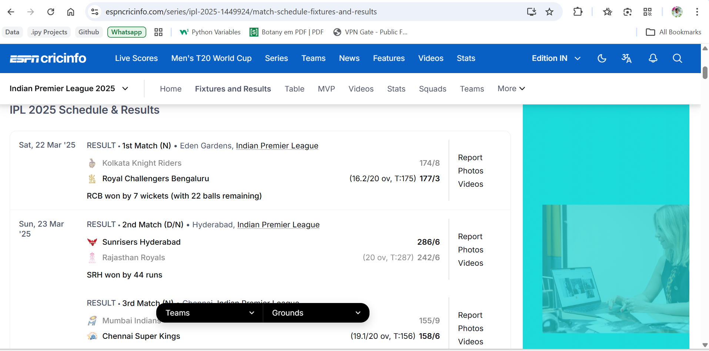
Web Scraping
Source: ESPN Cricinfo
Requests and Beautiful Soup are used.
Indian Premier League 2025
Some matches data is not scraped.
Ball-by-Ball data was scraped.
One row per delivery
The data scraped from the website is:
Match Number
Match Date
Innings
Venue
City
Toss Winner
Toss Decision
Batting Team
Bowling Team
Batter
Bowler
Over
Ball
Score

Slide 7
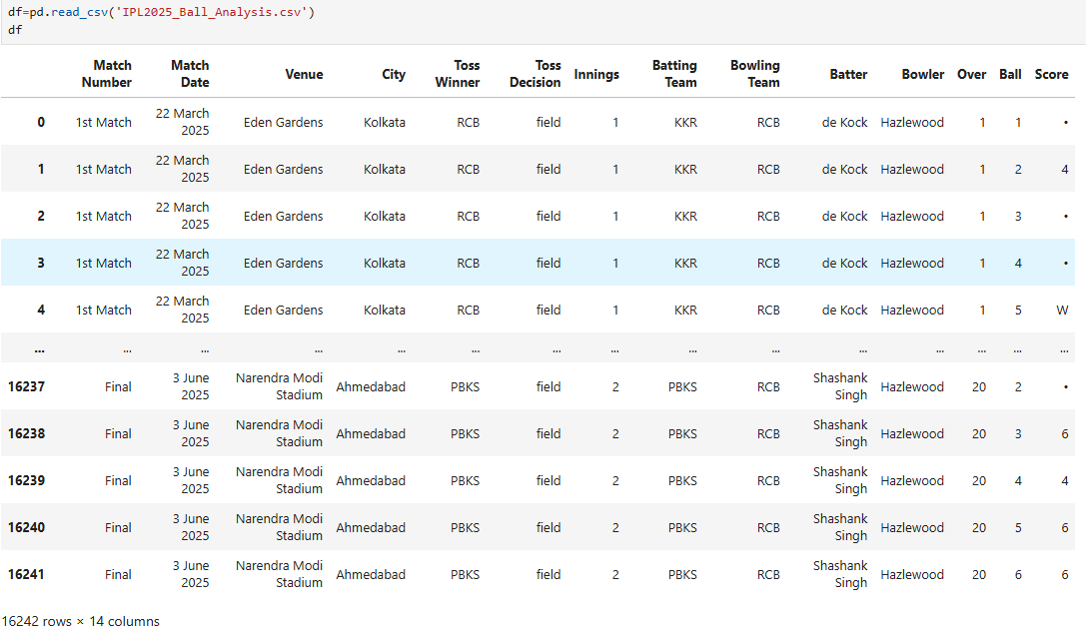
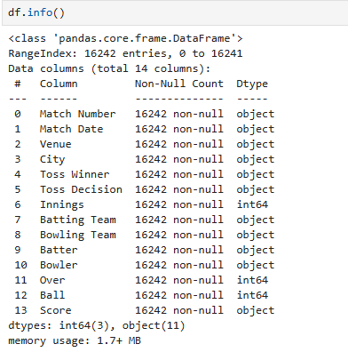
Dataset

Slide 8
Insights from the summary of the data
Dataset have 16242 record and 14 fields
Match Date is in object dtype → Convert to datetime
Score is in object dtype → Convert to int64
Toss Winner, Batting Team, Bowling Team names are in short form, like Sunrisers Hyderabad as SRH → Convert the team names to full names
Batter and Bowler names are not extracted clearly replace them properly
Score filed is in object dtype and it contains the mixed score values from the extract → Bat_runs, Extras, and Wicket
Create a Total_runs field it contains the runs of Bat_runs + Extras.
Toss Decision is in lowercase → Convert to Title case.
No missing (NULL) values detected.

Slide 9
Data Cleaning
Batting Team, Bowling Team and Toss Winner names are replaced with their full names.
Toss Decision is converted to the Title case.
Bat_runs, Extras and Wickets fields are parsed from the Score field.
A new Total_runs field is created. This field is created by adding the Bat_runs and Extras per delivery.
Extracted the unique batters and bowlers from the each team and replaced the inconsistent names with the consisted names.
Type conversion is done on the Match Date field from object to datetime datatype.
Match Number field data r are replaced from 1st Match to 1 except playoff matches.
A new Phase field was created based on the below condition:
Over 0 to 6 → Power Play
Over 7 to 15 → Middle Overs
Over 16 to 20 → Death Overs
No missing (NULL) values detected.
After performing the data cleaning and manipulation the shape of the data changed. (16242,14) → (16242,19).

Slide 10
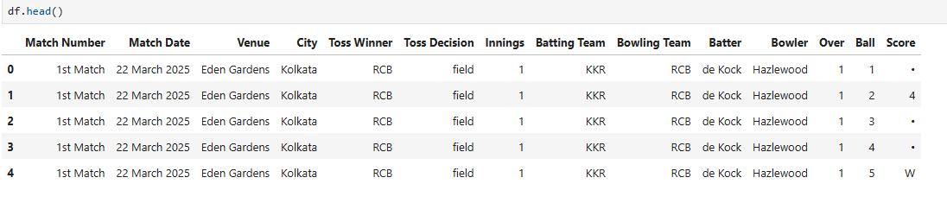
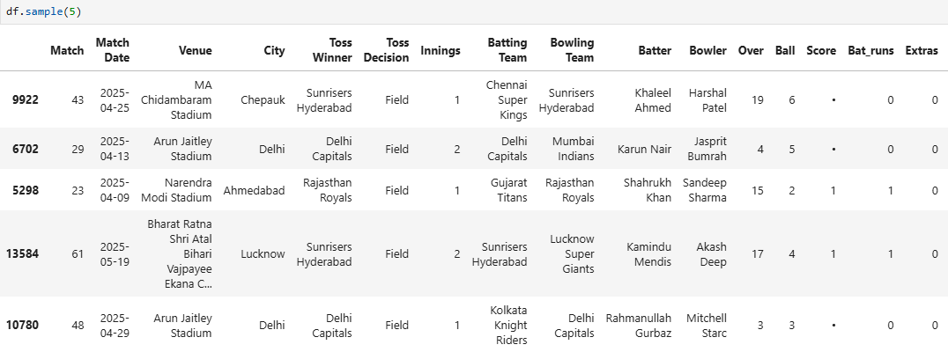
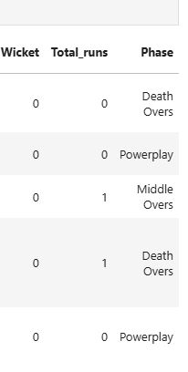
Data before cleaning
Data after cleaning

Slide 11
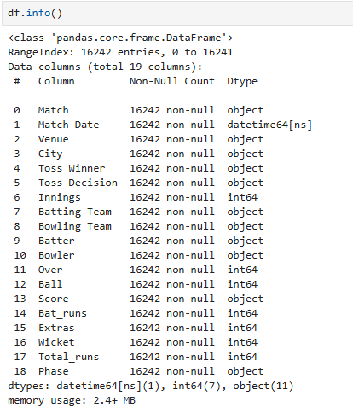
Data before cleaning
Data after cleaning

Slide 12
Univariate Analysis
There are total 10 unique teams are participated in the IPL..
The ten teams played in the IPL 2025 series are:
Royal Challengers Bengaluru
Kolkata Knight Riders
Rajasthan Royals
Sunrisers Hyderabad
Chennai Super Kings
Mumbai Indians
Delhi Capitals
Lucknow Super Giants-
Gujarat Titans
Punjab Kings
In the data set, 70 matches ball-by-ball data is available.
These matches are held in 58 days.
These 70 matches are held in 13 venues and in 14 cities.(Venue and City count is not matched that means there is some inconsistency in them)
The matches are held in March, April, May, June months. In these months most of the matches are held in the April month.

Slide 13



In the entire IPL 2025 series, the total runs scored by all the teams are 24838.
Total Bat_runs scored by the all the teams are 23703.
Total Extras given by the all the teams are 1135.
In the total runs most of the contribution is from the Bat_runs.
i.e., In the Total runs most of the runs came from the bat runs.
Extras impact is less on the total runs.
In the Total runs most of runs are singles.

Slide 14
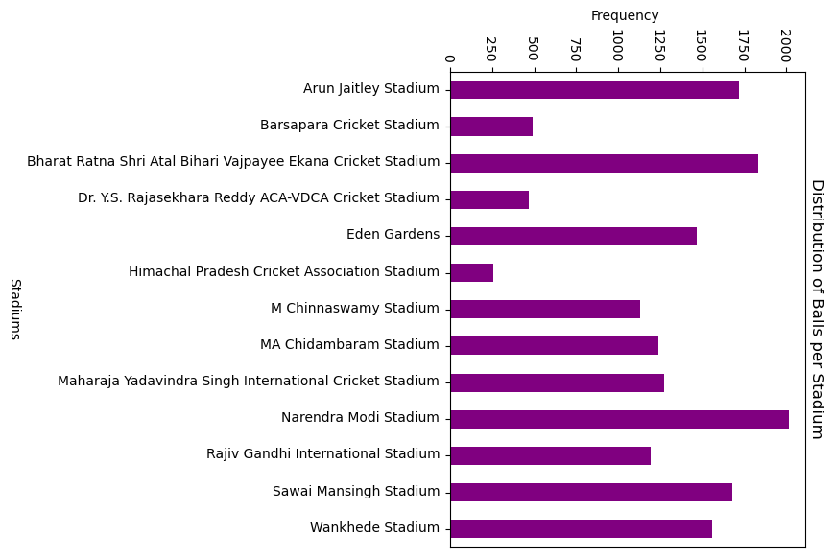
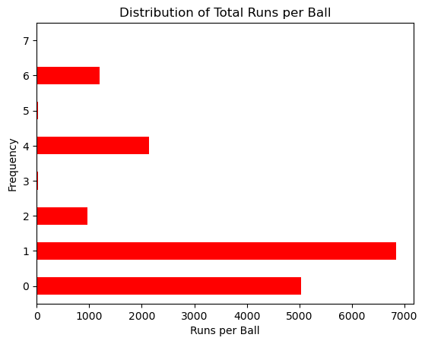
Data Visualization
Distribution of Balls per Stadium
Narendra Modi Stadium recorded the highest number of deliveries, indicating it hosted the most matches.
Bharat Ratna Shri Atal Bihari Vajpayee Ekana Cricket Stadium and Arun Jaitley Stadium also had high match activity.
Some venues like Himachal Pradesh Cricket Association Stadium had significantly fewer deliveries, indicating limited match hosting.
Distribution of Runs per Ball
Most deliveries resulted in 0 or 1 run, showing that dot balls and singles dominate T20 gameplay.
Higher scores (4s and 6s) occur less frequently but contribute significantly to total runs.
The distribution is right-skewed, meaning high scores are rare but impactful.
Consistent scoring (singles) builds innings, while boundaries accelerate totals.

Slide 15
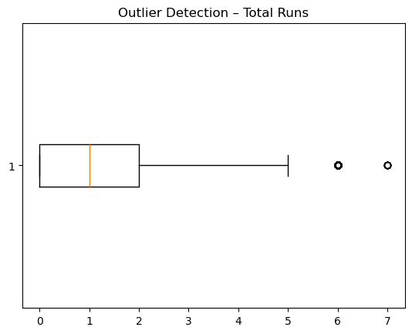
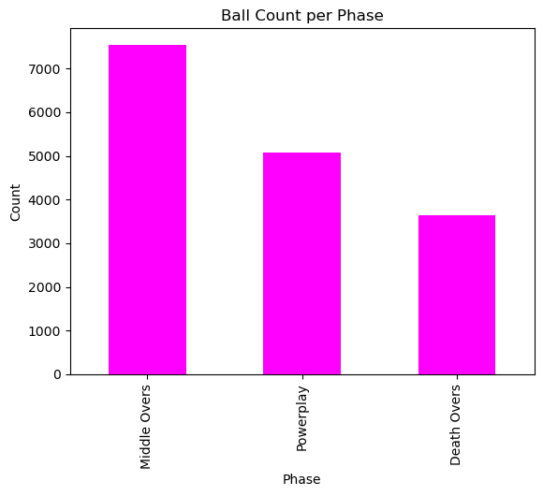
Outlier Detection (Total Runs per Ball)
The box plot shows that most values lie between 0–2 runs per ball.
Extreme values like 6 and 7 runs are outliers, occurring rarely.
Median is around 1 run per ball, confirming typical scoring behavior.
Ball Count per Phase
Middle Overs (7–15) have the highest number of deliveries.
Followed by Powerplay (0–6) and then Death Overs (16–20).
Middle overs dominate the game in terms of volume.
This phase plays a critical role in building or controlling the innings.

Slide 16
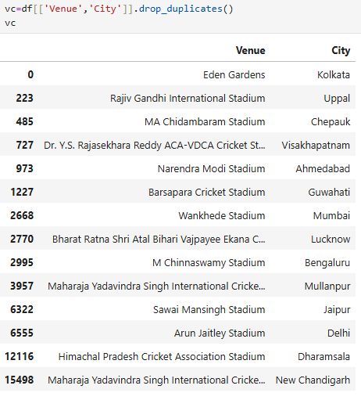
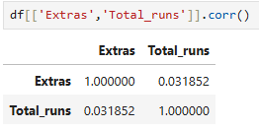
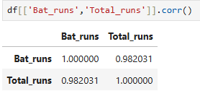
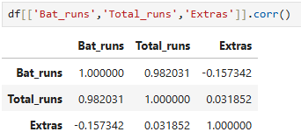
Bivariate Analysis
Based on the central tendency analysis, in every match together in both innings the teams are scoring 361 runs
From that in each innings each team is scoring 180-185 runs.
Correlations is performed for the Total_runs vs Extras, Bat_runs vs Total_runs , and Bat_runs vs Total_runs vs Extras.
From this Bat_runs and Total_runs have Strong Positive Correlation.
Extras and Total_runs have Weak Positive Correlation.
Bat_runs and Extras have Weak Negative Correlation.
From the above correlations Bat_runs are highly impacting the Total_runs

Slide 17
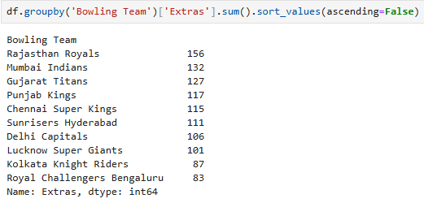
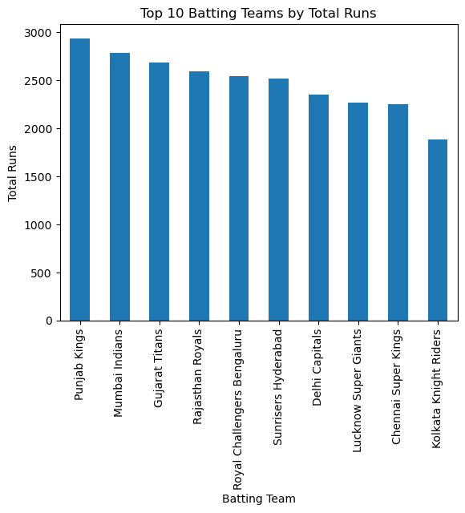
Royal Challengers Bengaluru and Kolkata Knight Riders conceded less extras when compared to the other teams .
From this we can say that the Royal Challengers Bengaluru has the best bowlers and bowling unit.
Top 10 Batting Teams by Total Runs
Punjab Kings scored the highest total runs, indicating dominant overall batting performance.
Mumbai Indians and Gujarat Titans follow closely as strong batting sides.
Kolkata Knight Riders recorded the lowest total runs among the teams.
Punjab Kings had the most consistent high-scoring batting lineup in the tournament.

Slide 18
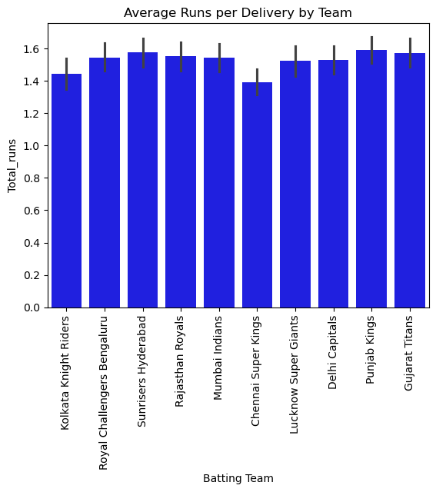
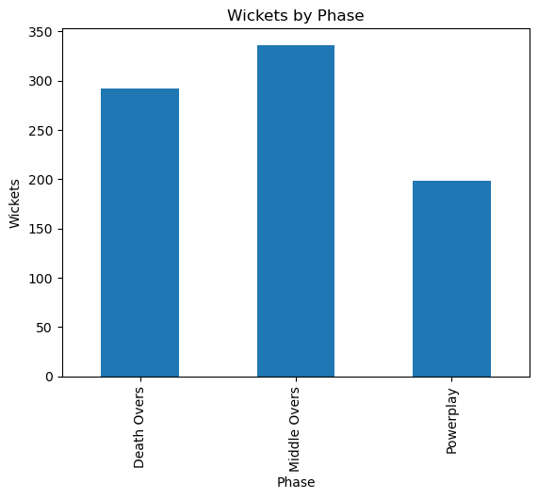
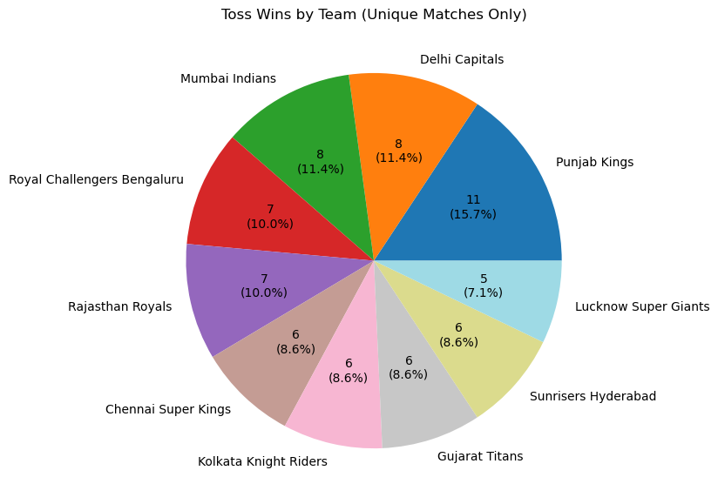
Average Runs per Delivery by Team
Punjab Kings and Gujarat Titans show the highest average runs per ball → strong scoring efficiency.
Chennai Super Kings has the lowest run rate → relatively slower scoring.
Most teams fall within a narrow range → competitive balance across teams.
Higher strike rate (runs per ball) directly reflects batting efficiency, not just total runs.
Wickets by Phase
Middle Overs (7–15) recorded the highest number of wickets.
Followed by Death Overs, while Powerplay has the least wickets.
Middle overs are the most critical phase for breaking partnerships.
Teams rely on bowlers in this phase to control the game.
Toss Wins Distribution
Punjab Kings won the most tosses (11 times).
Lucknow Super Giants won the fewest tosses (5 times).
Toss wins are relatively evenly distributed among teams.
Toss advantage exists but is not extremely skewed, meaning outcomes depend more on performance than luck.

Slide 19
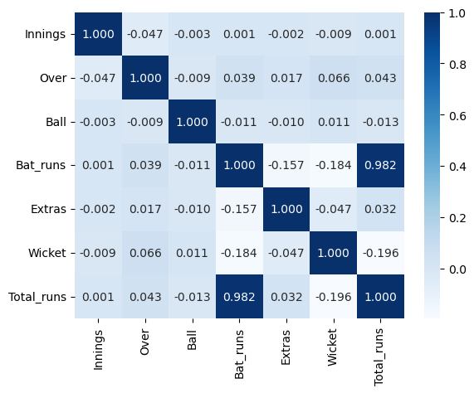
Multivariate Analysis
Batting Runs vs Total Runs
Strong positive correlation (≈ 0.98) between Bat_runs and Total_runs.
Batting contribution is the primary driver of total score.
Extras have minimal influence compared to bat runs.
Extras Relationship
Weak correlation between Extras and Total_runs (~0.03).
Slight negative correlation with Bat_runs (-0.157).
Extras do not significantly impact match totals.
High extras do not necessarily mean higher scoring matches.
Wickets Impact
Wickets show a negative correlation with Total_runs (-0.196).
More wickets → lower total score.
Wicket-taking is critical for restricting runs.

Slide 20
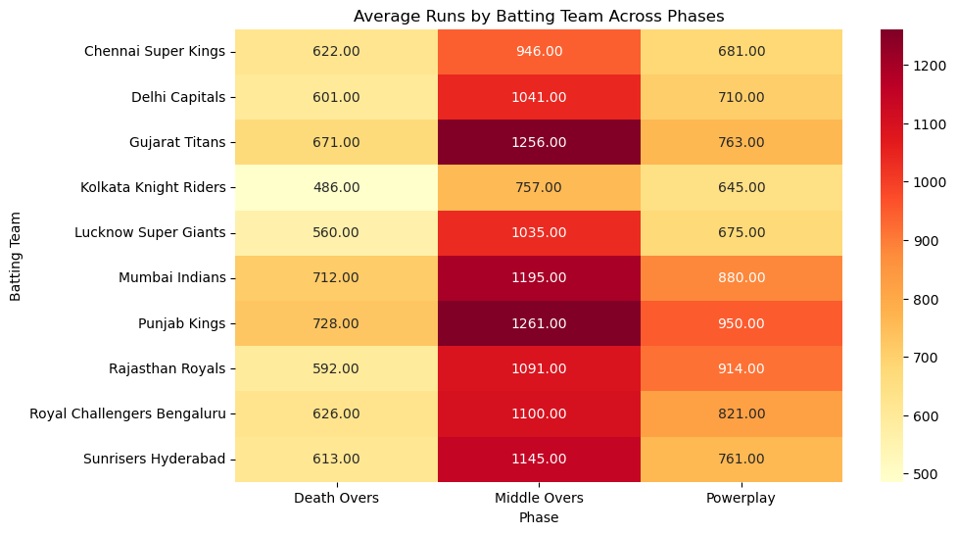
Powerplay Performance
Powerplay scores are moderate across teams.
Punjab Kings leads (~950 runs).
Early overs are used for controlled aggression, not maximum scoring.
Middle Overs Dominate
All teams score maximum runs in Middle Overs (7–15).
Middle overs are the most crucial phase for building innings.
Teams focus on run accumulation rather than aggression alone.
Death Overs Trends
Death overs show lower totals compared to middle overs.
Contrary to expectation, death overs are not the highest scoring phase overall.
Likely due to:
Pressure situations
Wickets falling
Defensive bowling strategies
Top Performing Teams
Punjab Kings and Gujarat Titans scored the highest runs in middle overs (~1250+).
Mumbai Indians also shows strong performance across all phases.
These teams have consistent batting strength across phases.

Slide 21
Key Insights
After performing the analysis, key insights are:
The four teams qualified for the playoff are
Punjab Kings
Royal Challengers Bengaluru
Mumbai Indians
Gujarat Titans
Punjab Kings have the highest winning percentage with 75% and later Royal Challengers Bengaluru has in the 2nd place with 66.66 %.
In the entire series First batting has the more winning success rate with 55.71% and Chasing has 44.28% winning success rate.
Sunrisers Hyderabad has the highest average score in the series,
Royal Challenger Bengaluru has the best bowling average in the series.
All teams are dominating in the Middle overs in the batting.

Slide 22
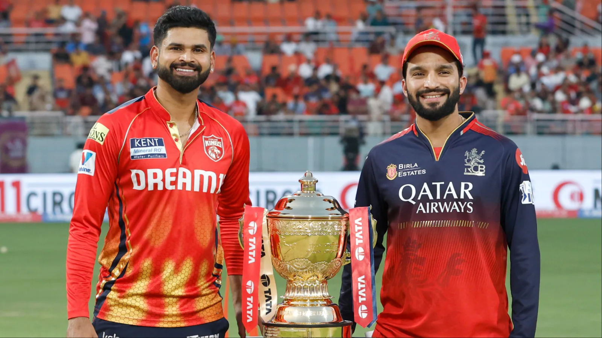
In the series, Royal Challenger Bengaluru and Punjab Kings are played the Final Match.
Punjab Kings won the toss and opted to field first.
In the final match Royal Challengers Bengaluru was first batted and scored 190 runs.
While Punjab Kings failed to chase these in the chasing and scored 184 runs,.
In the final match Royal Challengers Bengaluru won the Match.

Slide 23

In the Final Match, Royal Challengers Bengaluru defeated the Punjab Kings by 6 runs and won the IPL 2025 TROPHY.

Slide 24


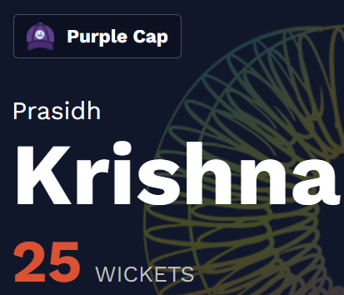


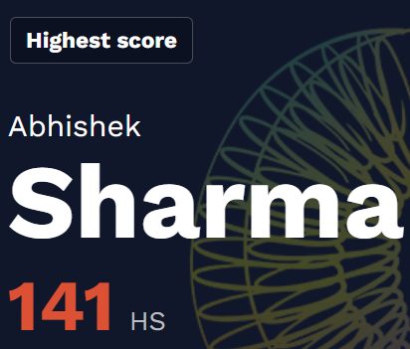
ORANGE CAP : B.Sai Sudarshan
PURPLE CAP: Prasidh Krishna
HIGHEST SCORING MATCH :
2nd Match Sunrisers Hyderabad scored 286 runs in an innings.
In the top 5 highest scoring innings. Top 3 is filled with the Sunrisers Hyderabad. Next two is filled by the Punjab kings. This showing the batting potential of the two teams.
HIGHEST SCORE BY AN INDIVIDUAL PLAYER :
Abhishek Sharma scored 141 runs

Slide 25
